Slide 1
BACHELOR'S PROJECT — FINAL DEFENCE
NEPSE Pro
NEPSE Stock Market Analysis & Portfolio Management Tool
Raghav Panthi
Reg. 2023-1-53-0370 | Symbol 23530222
Sishir Devkota
Reg. 2023-1-53-0220 | Symbol 23530121
Shuprabha Mainali
Reg. 2023-1-53-0221 | Symbol 23530122
Supervised by Mr. Sumant Yadav
School of Environmental Science and Management | Faculty of Science and Technology
Pokhara University, Nepal — July 2025

Slide 2






PRESENTATION ROADMAP
What We'll Cover
01
02
Background & Objectives
Requirements & Analysis
The problem NEPSE investors face, and what NEPSE Pro sets out to solve
Functional scope, prioritization, and system models
03
04
System Design
Implementation & Testing
Architecture, database, and interface flow
Build approach, charge engine, and test results
05
06
Live Walkthrough
Conclusion & Future Scope
Dashboard, charting, and portfolio screens
Achievements, limitations, and what's next
NEPSE PRO — PROJECT DEFENCE
2

Slide 3




CHAPTER 1 · BACKGROUND
Investing in NEPSE Is Harder Than It Should Be
NEPSE generates huge volumes of price, volume, and company data every day — but ordinary investors struggle to turn that data into decisions.
Fragmented Sources
Manual Tracking
No Charge Awareness
Poor Mobile Experience
Investors juggle the official NEPSE site, Merolagani, ShareSansar, and social media just to piece together a picture.
Holdings are tracked in notebooks or Excel sheets — messy, error-prone, and blind to real transaction costs.
No free platform calculates the true cost of a trade: broker commission, SEBON fee, DP charge, and CGT.
Most existing tools are desktop-only, while investors want to check the market on the move.
NEPSE PRO — PROJECT DEFENCE
3

Slide 4




CHAPTER 1 · OBJECTIVES
Project Objectives
Real-time & historical NEPSE data
Collect and display live and historical stock market data for every listed security.
Interactive charting
Candlestick charts across 8 timeframes with SMA, EMA, RSI, and MACD indicators.
Virtual portfolio management
A full paper-trading system with profit/loss tracking on every position.
Nepal-specific trading charges
Automatically compute broker commission, SEBON fee, DP charge, and Capital Gains Tax.
Personalized watchlist
Let investors save and monitor selected stocks across sessions.
NEPSE PRO — PROJECT DEFENCE
4

Slide 5


CHAPTER 1 · PURPOSE & SCOPE
What NEPSE Pro Does — and Doesn't
What the system does
What the system doesn't do
▸ Live index, market summary, top gainers/losers & full market watch
▸ This is not a real trading platform — no real orders are placed
▸ Candlestick charts, 8 timeframes, SMA / EMA / RSI / MACD
▸ Does not connect to bank accounts or payment systems
▸ Search all NEPSE-listed securities by symbol or name
▸ Does not provide financial advice or recommendations
▸ Personal watchlist with prices refreshed every 30 seconds
▸ Does not predict future stock prices
▸ Simulated buying/selling from Rs. 1,00,000 virtual cash
▸ Holdings, avg. buy price, unrealized P&L, transaction history
▸ No native iOS / Android app — browser-based only
▸ Email OTP + Google OAuth registration and login
▸ Fully responsive on desktop and mobile
NEPSE PRO — PROJECT DEFENCE
5

Slide 6

CHAPTER 2 · SURVEY OF TECHNOLOGIES
Comparison of Existing NEPSE Platforms
Platform | Strengths | Limitations
Official NEPSE Website | Trustworthy, official data | Complicated UI, no watchlist or portfolio tools
Merolagani.com | News, company info, basic charts | Basic charts, no portfolio tools, ad-heavy
ShareSansar.com | Market news & data | Not mobile-friendly, no personalization
TradingView (Global) | Pro charting, 100+ indicators | No NEPSE data, no Nepal-specific charges
Research Gap: No platform combines real-time data, technical analysis, AND personalized portfolio + charge tools in one place.
NEPSE PRO — PROJECT DEFENCE
6

Slide 7

CHAPTER 2 · RESEARCH GAP → SOLUTION
Closing the Gap
GAP No modern, user-friendly interface
GAP No personalized watchlist or dashboard
NEPSE PRO Clean, dark-themed, responsive UI built with React + Tailwind CSS 4
NEPSE PRO Live dashboard + personal watchlist refreshed every 30 seconds
GAP Limited portfolio management
GAP No accurate brokerage & tax calculation
NEPSE PRO Full paper-trading engine with FIFO/average-cost P&L tracking
NEPSE PRO Dedicated charge engine: commission tiers, SEBON fee, DP charge, CGT
GAP Limited technical analysis on NEPSE data
GAP Users juggle multiple websites
NEPSE PRO TradingView-inspired charts with SMA, EMA, RSI, MACD
NEPSE PRO One platform for data, analysis, watchlist & portfolio
NEPSE PRO — PROJECT DEFENCE
7

Slide 8
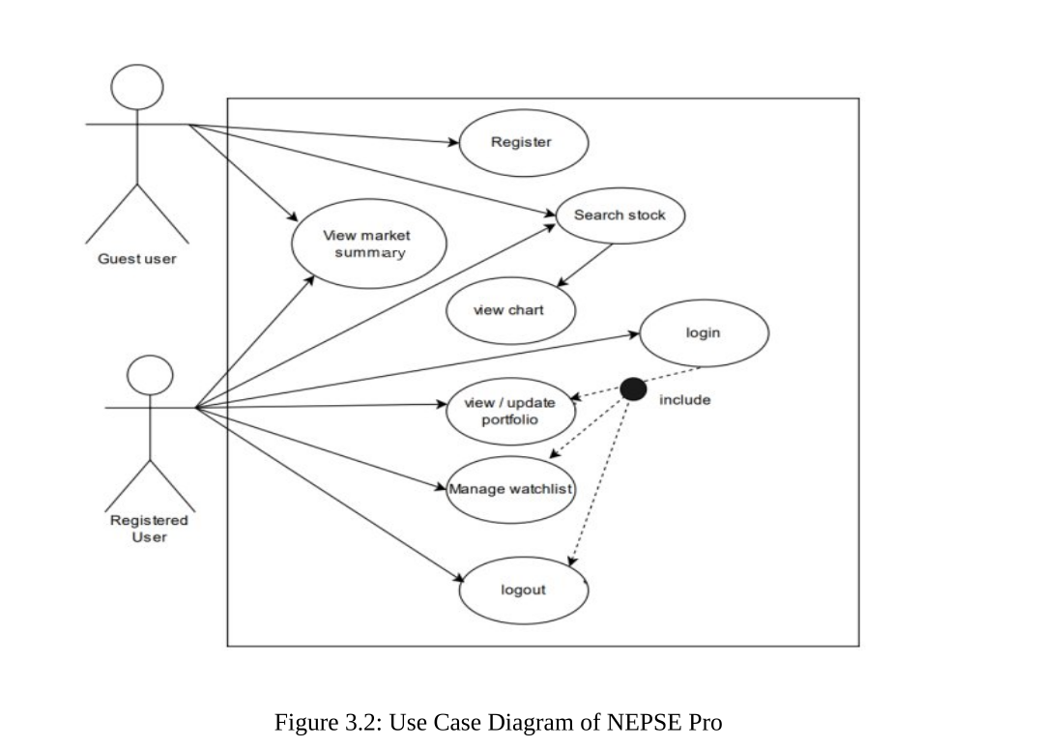
CHAPTER 4 · DESIGN

Slide 9
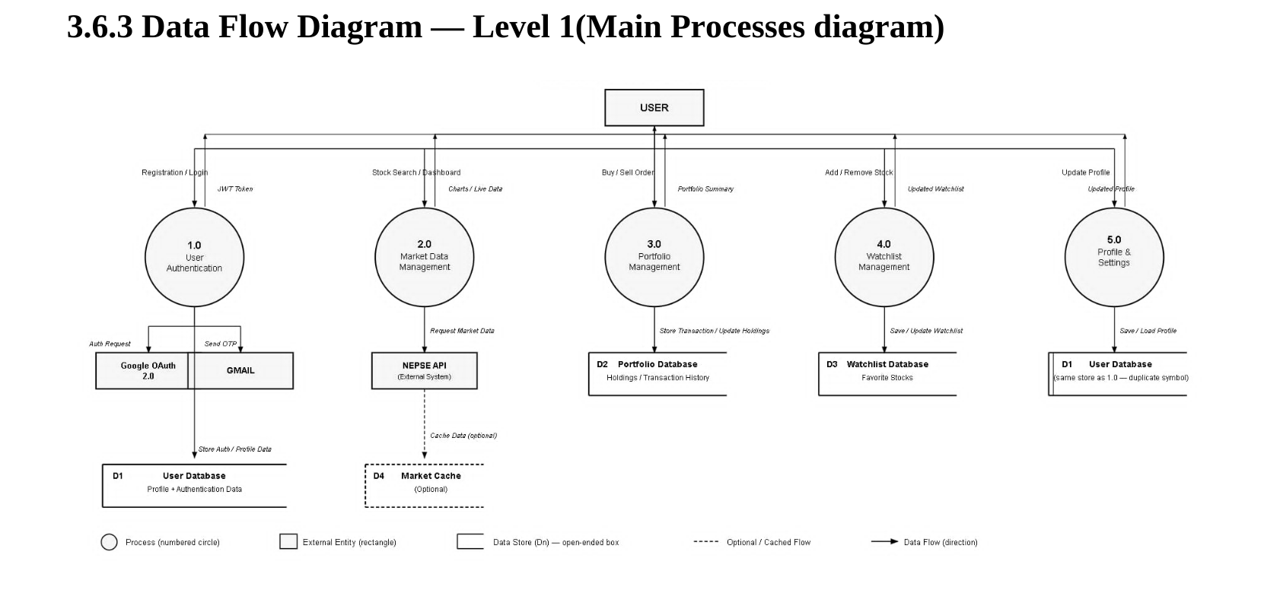

Slide 10
CHAPTER 4 · DATABASE DESIGN
Entity–Relationship Model
USERS
WATCHLIST
id (PK) · user_id (FK) symbol UNIQUE(user_id, symbol)
many
id (PK) name email (UNIQUE) password mobile / bio googleId / provider isVerified emailOTP + expiry cashBalance createdAt
PORTFOLIO
1
id (PK) · user_id (FK) symbol, quantity buy_price, buy_date
many
TRANSACTIONS
id (PK) · user_id (FK) symbol, qty, price type (BUY | SELL)
many
ON DELETE CASCADE — removing a user automatically clears their watchlist, portfolio, and transaction history.
NEPSE PRO — PROJECT DEFENCE
9

Slide 11

CHAPTER 4–5 · CORE CAPABILITIES
Key Features
Pro Charting
Portfolio Simulator
Nepal Charge Engine
8 timeframes with SMA, EMA, RSI & MACD, updated every 5 seconds intraday
Virtual cash balance with buy/sell, avg. cost, and live P&L
SEBON 5-tier commission, regulatory fee, DP charge & CGT — auto-computed
Watchlist
Dual Authentication
Responsive Design
Personalized tracking with live 30-second price refresh
Email + OTP verification, and Google OAuth 2.0 with JWT sessions
Fully dark-themed UI that works on desktop, Android & iOS browsers
NEPSE PRO — PROJECT DEFENCE
10

Slide 12

CHAPTER 5 · IMPLEMENTATION DETAIL
Nepal-Compliant Transaction Charges
Broker Commission Tier Structure
Transaction Amount (Rs.) | Rate
Up to 50,000 | 0.36%
50,001 – 5,00,000 | 0.33%
5,00,001 – 20,00,000 | 0.31%
20,00,001 – 1,00,00,000 | 0.27%
Above 1,00,00,000 | 0.24%
Capital Gains Tax (CGT)
7.5%
5.0%
Short-term profit
Long-term profit
No tax is applied on realized losses — verified in unit test UT-08.
+ 0.015% SEBON regulatory fee + Rs. 25 fixed DP charge per sell
All four charges — commission, SEBON fee, DP charge, CGT — are shown to the user before a trade is confirmed.
NEPSE PRO — PROJECT DEFENCE
11

Slide 13



CHAPTER 3 · TECHNOLOGY STACK
Built With Modern, Open-Source Tools
Frontend
Backend
Data & Auth
Deployment
• React 19
• Express.js v5
• SQLite
• Vercel (Frontend)
• TypeScript
• JWT
• Render (Backend API)
• Vite
• bcrypt
• @rumess/nepse-api
• Tailwind CSS 4
• Google OAuth 2.0
• HTTPS everywhere
• Lightweight Charts
• Email OTP
• Git / GitHub
Total development cost: Rs. 500 (printing & binding only — everything else is open-source or free-tier)
NEPSE PRO — PROJECT DEFENCE
12

Slide 14
CHAPTER 5–6 · TESTING & RESULTS
Testing Summary
12
15
12
Unit Tests
Integration Tests
Beta User Tests
100% pass
100% pass
91.6% pass
Sample Unit Test Cases
Sample Integration Test Cases
ID | Function | Input → Expected
UT-01 | calculateBrokerCommission | Rs. 50,000 → Rs. 180.00
UT-06 | calculateCapitalGainsTax | profit 10,000, 200 days → Rs. 750.00
UT-11 | buildPortfolioState | SELL qty > held → throws error
ID | Endpoint | Result
IT-06 | /api/auth/login | 200 {token}
IT-11 | /api/user/trade (BUY) | 201 {transaction}
IT-15 | Protected route, no token | 401 Unauthorized
NEPSE PRO — PROJECT DEFENCE
13

Slide 15
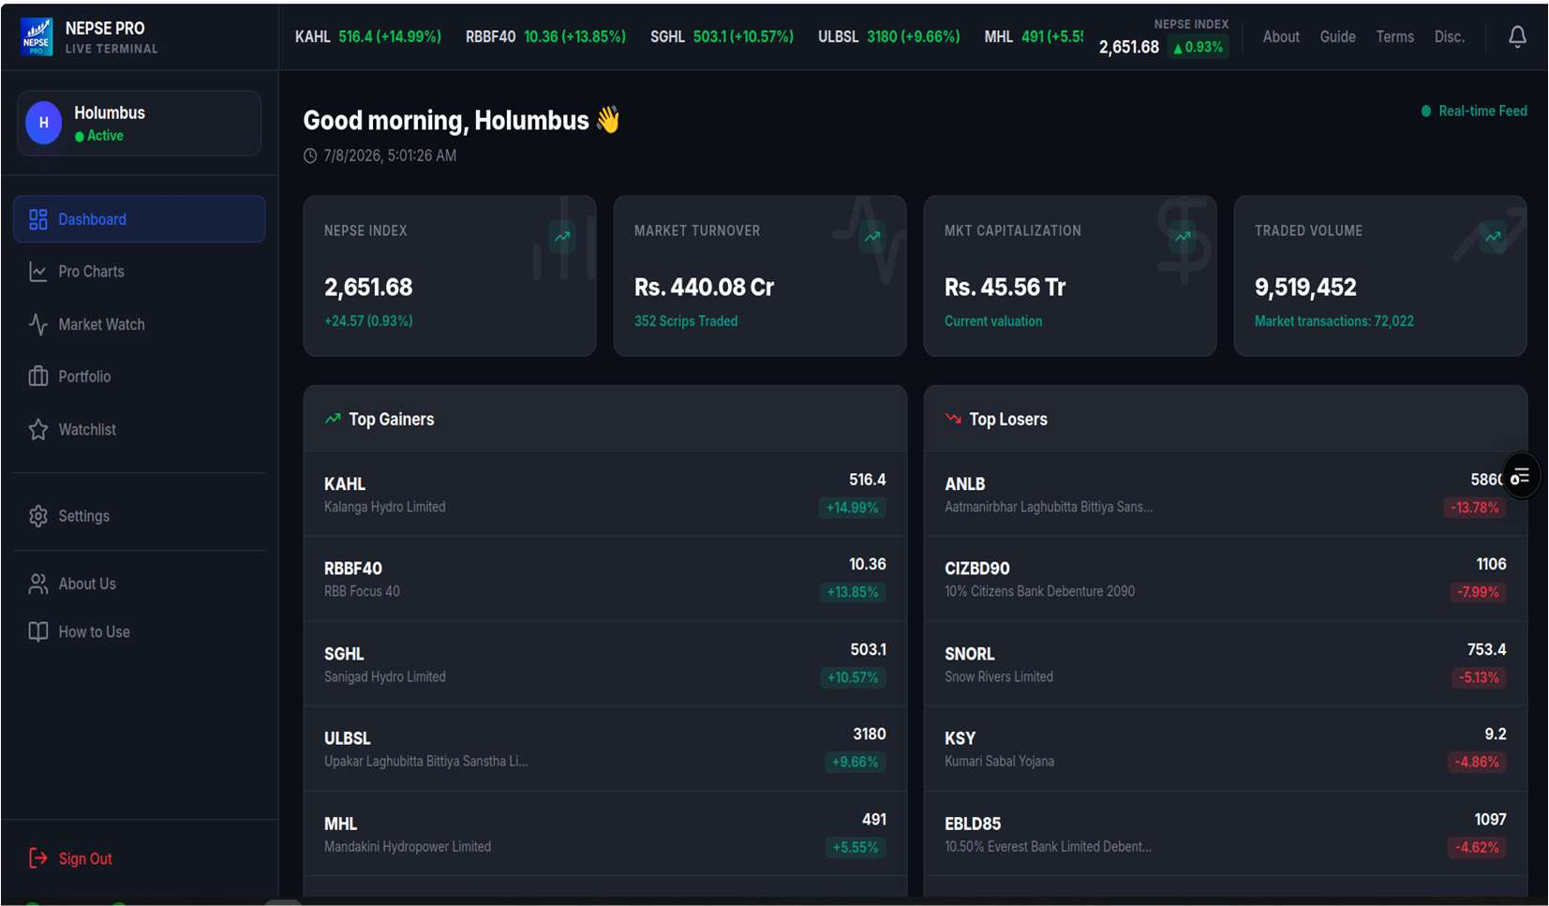
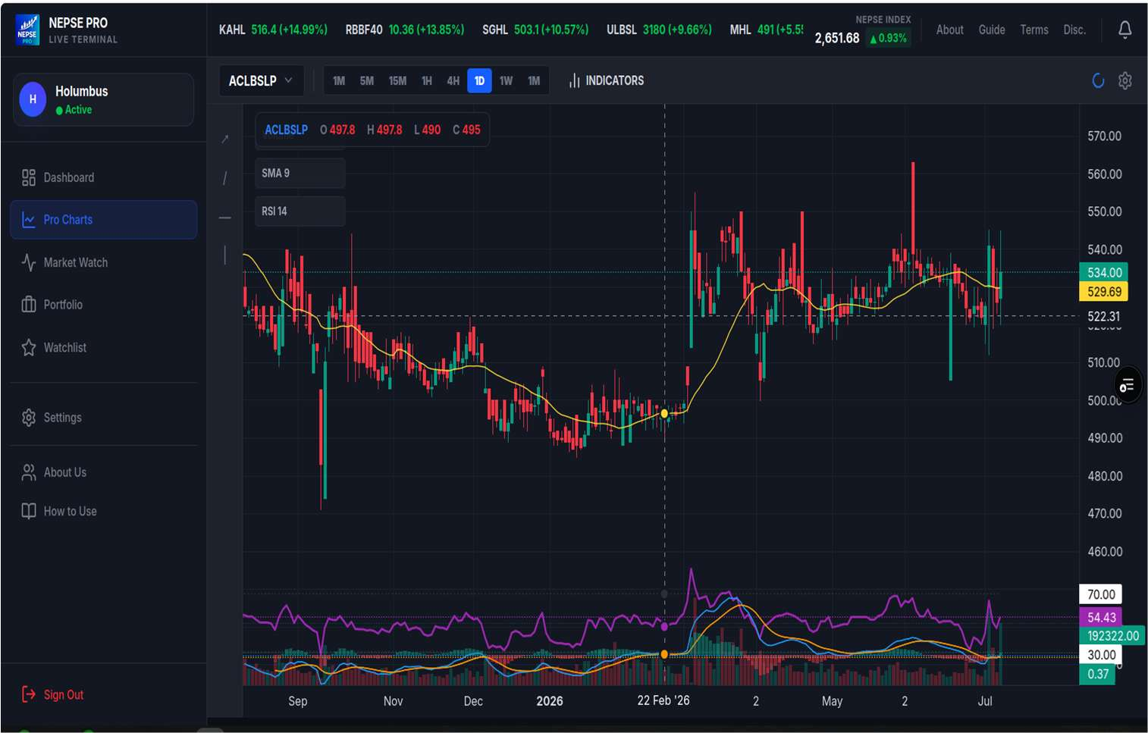
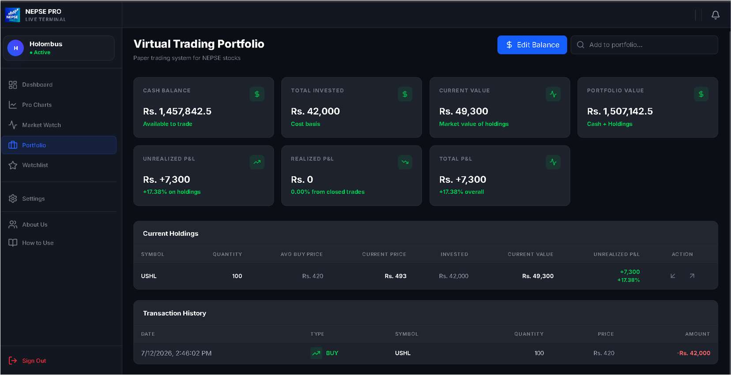
LIVE APPLICATION WALKTHROUGH
NEPSE Pro in Action
Live Dashboard
Pro Charts
Portfolio
Index, market summary, top gainers & losers
Candlesticks with SMA, RSI & volume overlay
Holdings, unrealized P&L & transaction history
visit : https://nepse-pro.vercel.app/
Also available: Market Watch, Watchlist, Google OAuth sign-in
NEPSE PRO — PROJECT DEFENCE
14

Slide 16


CHAPTER 1 · DELIVERED
Key Achievements
Deployed publicly
Real-time data integration
Professional charting engine
Frontend on Vercel, backend API on Render — accessible 24/7
@rumess/nepse-api with in-memory caching for live index & market data
TradingView-inspired charts, 8 timeframes, 4 indicators, drawing tools
Nepal-compliant charge engine
Dual authentication
FIFO portfolio engine
5-tier commission, SEBON fee, DP charge, and CGT calculated correctly
Email OTP (Nodemailer) + Google OAuth 2.0, JWT session management
Reconstructs holdings & realized P&L from ordered transaction history
NEPSE PRO — PROJECT DEFENCE
15

Slide 17

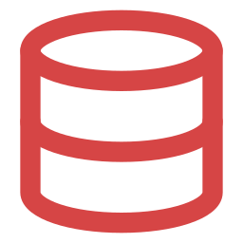



CHAPTER 7 · HONEST ASSESSMENT
Current Limitations
Virtual trading only
No real orders through licensed NEPSE brokers
Dependent on unofficial API
Downtime or changes upstream can affect functionality
SQLite at small scale
Suitable for academic use, not high-concurrency production
Polling, not WebSockets
Fixed-interval refresh can introduce slight delay
Limited fundamental analysis
No EPS, P/E ratio, book value, or dividend history yet
No price alerts
Users cannot yet set target-price notifications
NEPSE PRO — PROJECT DEFENCE
16

Slide 18



CHAPTER 7 · WHAT'S NEXT
Future Scope
Real-time streaming via WebSockets.
Price alert notifications
Fundamental analysis (EPS, P/E, dividends)
Advanced portfolio analytics & risk metrics
Real portfolio import from brokers / CSV
NEPSE news & SEBON announcements feed
Database upgrade to PostgreSQL
Native mobile app (React Native)
AI-based market insights & summaries
NEPSE PRO — PROJECT DEFENCE
17

Slide 19



CHAPTER 7 · CONCLUSION
NEPSE Pro Delivers on Its Objectives
A single, cost-effective platform that brings real-time NEPSE data, technical analysis, and Nepal-specific charge-aware portfolio simulation together — something no existing platform offers.
Cost-effective & scalable
Secure by design
Built entirely on open-source technology for approx. Rs. 500 total
JWT, bcrypt hashing, OTP verification & Google OAuth 2.0
well tested
A learning platform
100% unit & integration pass rate across 27 test cases
Practical value for students, beginners & retail investors alike
NEPSE PRO — PROJECT DEFENCE
18

Slide 20
THANK YOU
Questions & Discussion
Raghav Panthi · Sishir Devkota · Shuprabha Mainali
Supervised by Mr. Sumant Yadav — School of Environmental Science and Management, Pokhara University

